Slide 1
Section 5.5 Solving Inequalities with Squares
© Copyright all rights reserved to Homework depot: www.BCMath.ca

Slide 2
Example: Solve the Following Inequalities:
© Copyright all rights reserved to Homework depot: www.BCMath.ca

Slide 3
Solving Inequalities with Squares:
When you have inequalities with squares, isolate the square and then square root both sides
You will end up with 2 answers [Positive & Negative]
Draw a number line and the roots on the number line
You will get three different domains on the number line
Pick a value from each domain and check if it satisfies the inequality
Domains that satisfy the equality will be your solution
Note: Make sure you have the correct INEQUALITY SIGN
© Copyright all rights reserved to Homework depot: www.BCMath.ca

Slide 4
Practice: Solve the Following Inequalities:
© Copyright all rights reserved to Homework depot: www.BCMath.ca

Slide 5
II) Steps for Solving Inequalities with Factoring
Factor the trinomial and find the roots [solutions]
In general when we graph a trinomial, we get a U-shaped graph called a ‘Parabola’
Indicate which points satisfy the inequality
Above/Below/Equal the X-axis
the domain that satisfy the inequality be the solution
Ex: Solve the Inequality
y
5
4
the roots are 2 and -2
3
2
Sketch the Domain
1
x
-3
-2
-1
0
1
2
3
-1
-2
-3
© Copyright all rights reserved to Homework depot: www.BCMath.ca

Slide 6
Practice: Solve the Inequality
Find the roots (Factor)
Graph: Parabola, the roots are
-1/3 and 3.5
Look for points Above the X-axis
y
Sketch the Domain
15
10
5
x
-1
0
1
2
3
4
5
-5
-10
-15
-20
-25
© Copyright all rights reserved to Homework depot: www.BCMath.ca

Slide 7
III) Developing an Inequality Equation:
Ex: Write a quadratic inequality with the following solution:
Draw the solution on a number line:
Draw a Parabola
The roots are 3 and 7.
The factors will be
The solution is the part ABOVE the X-axis (Greater)
© Copyright all rights reserved to Homework depot: www.BCMath.ca

Slide 8
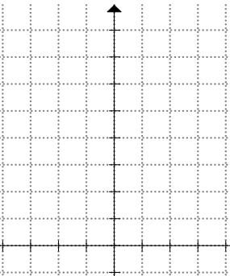
IV) Why is a Quadratic Function U-shaped?
If we make a TOV, plot the coordinates, and connect the dots, the resulting shape is a Parabola
© Copyright all rights reserved to Homework depot: www.BCMath.ca

Slide 9
Homework:
Assignment 5.5
© Copyright all rights reserved to Homework depot: www.BCMath.ca

